Slide 1
El mundo al revés: Bash en Windows y PowerShell en Linux
Diego Martínez Gil
Technical Evangelist – Microsoft
diego.martinez@microsoft.com
@diegomrtnzg

Slide 2

Diego Martínez
Technical Evangelist
Developer eXperience @ Microsoft
OSS, DevOps, Cloud and Infrastructure
Academic
Contact
diego.martinez@microsoft.com
@diegomrtnzg

Slide 3
WARNING All features you will see are in preview

Slide 4
Agenda
Microsoft loves Linux
Don´t fight. Better together
Bash on Ubuntu on Windows
It´s real. Develop your apps where you want
PowerShell on Linux
Windows admins: manage Linux as a Windows in the same way
Microsoft OSS
We are really involved in Open Source world

Slide 5
Microsoft
Linux

Slide 6
Bash on Ubuntu on Windows

Slide 7
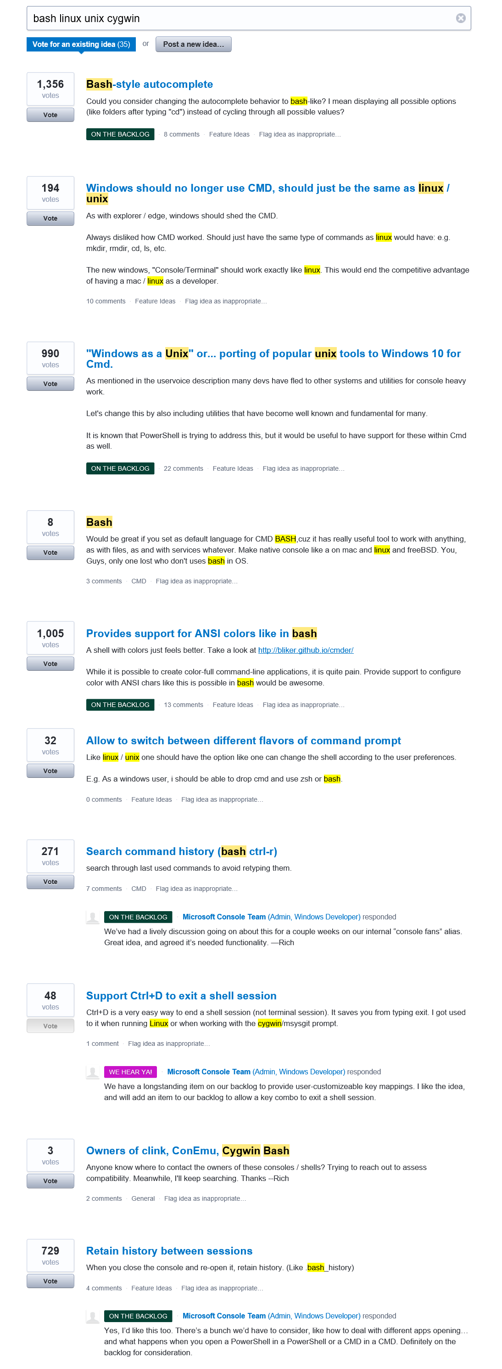
Response to feedback
Feedback on the Windows command-line
https://wpdev.uservoice.com/forums/266908-command-prompt/filters/top
Two themes emerged
Improve the Windows Console
Bring Unix/Linux tools to Windows
Bash, ssh, grep, sed, awk, etc.
Better support platforms used by OSS projects (esp. Ruby, Python, etc.)

Slide 8
Why *NIX tools on Windows? We live in a heterogenous world
Windows and Linux are more prevalent than ever before
Many open source projects depend on Linux features
We want Windows to be the place for you to do ALL your work
All the platforms
All the devices

Slide 9
The solution
Integrate *NIX tools and environment into Windows
Run native Linux binaries on Windows
No VMs – real Linux tools
On Windows. In Windows. Together.
Bash on Ubuntu on Windows
Windows Subsystem for Linux (WSL)
New distro-agnostic, Linux compatible subsystem

Slide 10
DEMO
Bash on Ubuntu on Windows

Slide 11
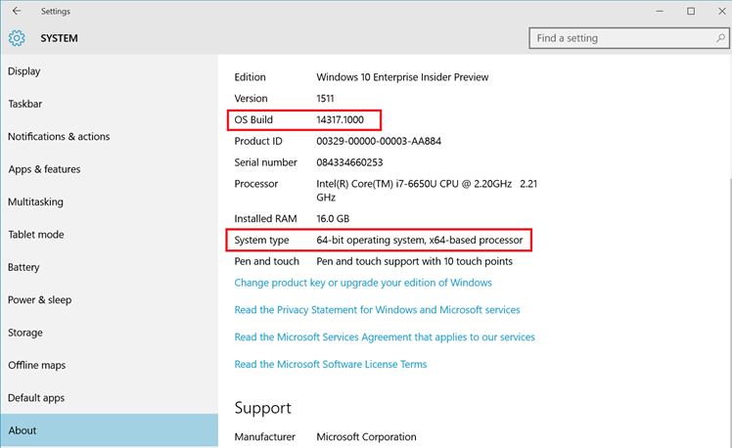
Activating Windows Subsystem for Linux
Prerequisites:
Must be running on an AMD/Intel x64 compatible CPU & OS
Must be running a 64-bit version of Windows 10 Anniversary Update version 16xx / build 14316 or later
Notes:
Activating Windows Subsystem for Linux
First things first, ensure you have compatible hardware. WSL requires an AMD/Intel x64 compatible CPU & OS
Next ensure you are running a 64-bit version of Windows 10 Anniversary Update version 16xx / build 14316 or later

Slide 12
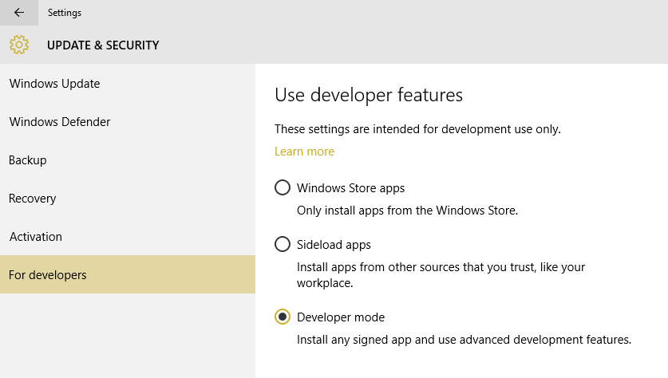
Activating Windows Subsystem for Linux
Turn on Developer Mode:
Settings | Update & Security | For Developers | Check the Developer Mode radio button:
Notes:
Next, head to settings and turn on developer mode

Slide 13
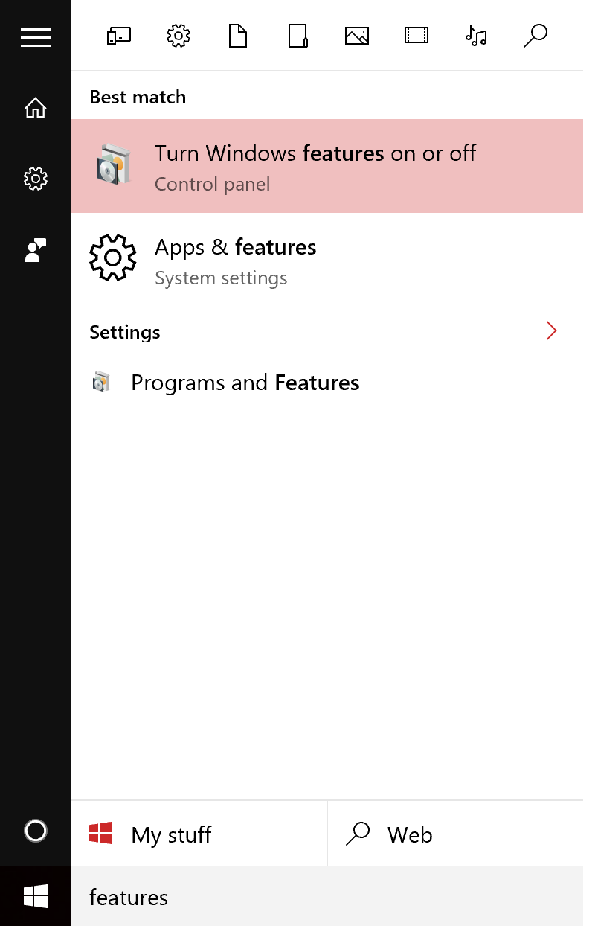
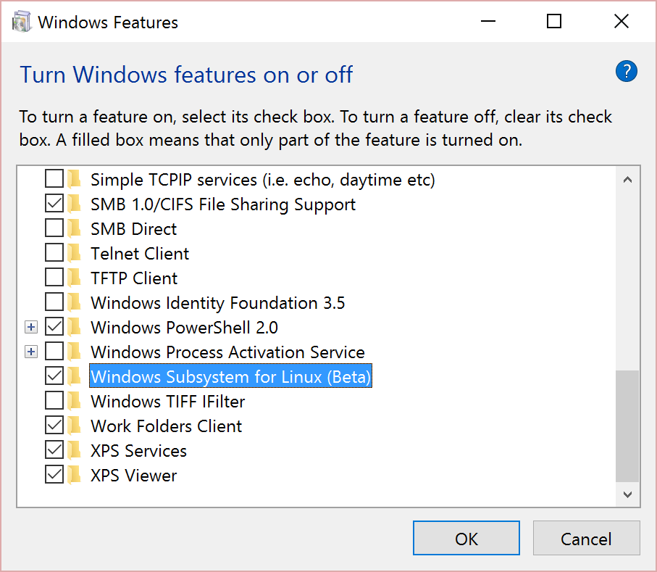
Activating Windows Subsystem for Linux
From the start menu, open “Turn Windows Features on or off”:
Notes:
Now head to Windows feaature and check the box next to Windows Subsystem for Linux (Beta) and reboot

Slide 14
What did we just see?
Linux tools
Linux ELF64 binaries
Running directly on …
Windows subsystem for Linux
New feature in the Windows kernel
Exposes a Linux-compatible syscall layer and process model
Supports fork() and many Linux syscalls
User-mode
Ubuntu
Bash, git, Ruby, etc.
Windows Kernel
Kernel
Windows Subsystem for Linux
Syscalls
read
write
open
fork
…

Slide 15
What works … and what doesn’t?
What works … and what didn’t?
This is a preview of a brand new technology
THERE WILL BE GAPS!
Many of your favorite Linux tools Work Well In Testing
Bash, apt-get, Ruby, Git, Python…
Known issues
Networking – not working yet!
MySQL has issues
We’re working hard to close gaps
MANY scenarios are untested …

Slide 16
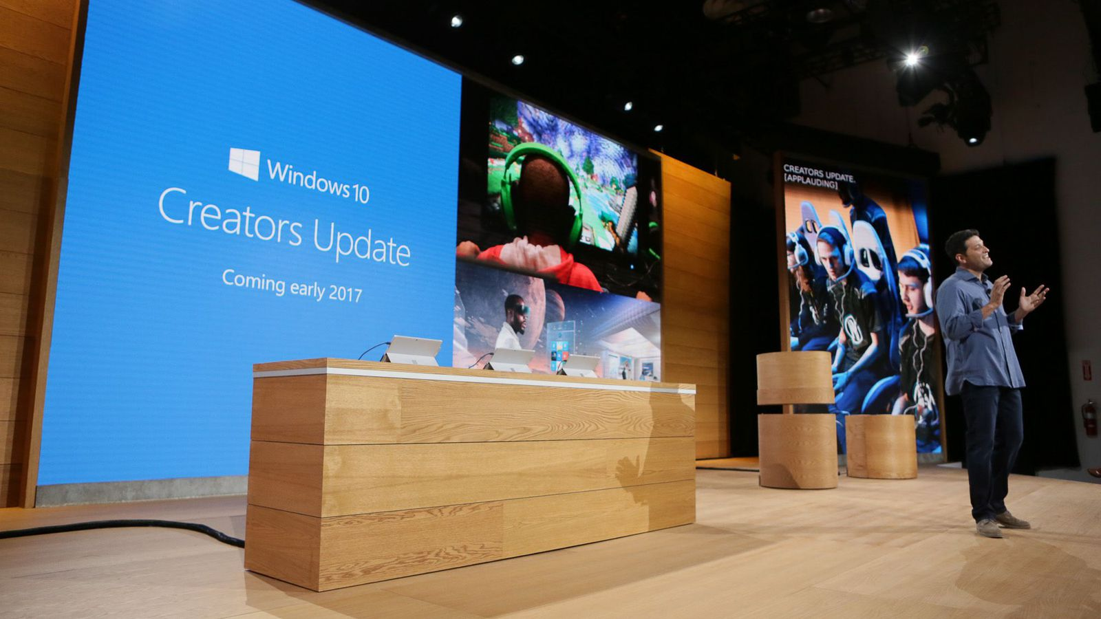

Slide 17
What’s new in Windows 10 Creators Update
Ubuntu 16.04 support
More compatibility
Core tools, Shells, Dev tools, Languages & platforms, Systems & Services…
Network improvements
Ifconfig, network connection enumeration, ping, icmp…
File system improvements
Inotify…
More improvements
https://blogs.msdn.microsoft.com/commandline/2017/04/11/windows-10-creators-update-whats-new-in-bashwsl-windows-console/
Notes:
https://blogs.msdn.microsoft.com/commandline/2017/04/11/windows-10-creators-update-whats-new-in-bashwsl-windows-console/

Slide 18
Community
More info
https://blogs.msdn.microsoft.com/wsl/
Documentation
https://msdn.microsoft.com/commandline/wsl/about
UserVoice (Ideas & asks)
https://wpdev.uservoice.com/forums/266908-command-prompt/filters/top
Feedback
https://github.com/Microsoft/BashOnWindows/issues

Slide 19
PowerShell on Linux

Slide 20
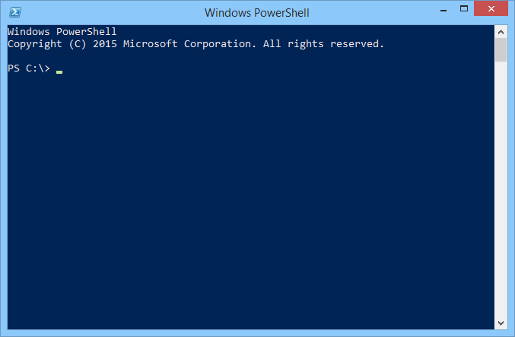
What is PowerShell?
Task-based command-line shell and scripting language built on the .NET Framework.
Help IT professionals control and automate the administration of Windows (and now Linux) and the apps that run on them

Slide 21
What is the PowerShell journey?
PowerShell is built on .NET
You can only use in Windows
.NET Core change the scenario
We port it to Linux (alpha version)
Same tool to manage everything from anywhere
Windows + Linux + new users can use:
Interactive scripting language
Heterogeneous automation
Configuration management
Interoperates with other tools

Slide 22
Is it the same PowerShell? No, we add some changes
PowerShell Editor Services
You can choose your editor: VS Code, Sublime…
Coming soon: OpenSSH as a native transport
You can choose SSH or WINRM as a transport

Slide 23
DEMO
PowerShell on Linux

Slide 24
PowerShell DSC for Linux
Configuration management platform
Extend PowerShell functionality
Deploy and manage configuration data for software services and their environment
Features
Server SO
Built-In resources: nxArchive, nxEnviroment, nxFile, nxGourp, nxScript, nxUsers…
Distributing configurations modes: Push (WS-Man) and Pull (HTTP/HTTPS)
Protection against configuration drift

Slide 25

PowerShell + OMS
Operations Management Suite
Cloud management solution
Visibility and control applications and workloads across cloud and on-premise
OMS Automation
Highly available and scalable management service
PowerShell + PowerShell DSC
Azure | AWS
Modern
management

Slide 26
What works … and what doesn’t?
This is a alpha version
THERE WILL BE GAPS!
Many of your favorite PowerShell tools Work Well In Testing
Shell, scripting, automation, linux utilities, modules: AWS, Azure…
Known issues
Sudo, exec, redirection issues, remoting support, missing commands
We’re working hard to close gaps
MANY scenarios are untested …

Slide 27
Community
More info
https://blogs.msdn.microsoft.com/powershell/
Open Source
https://github.com/PowerShell/PowerShell
We need your help!
RFCs, issues and contributions
Also, we are working with Chef, AWS, VMWare, Google…
GitHub
https://github.com/PowerShell/PowerShell

Slide 28
Microsoft OSS

Slide 29
How Microsoft Works with Open Source
Use open source in Microsoft products
Ensure we have Microsoft “value add”
Contribute code as open source to the community
Engage constructively with the community
Operating systems: Linux is a 1st class citizen
Field sellers, support, and services ramp up

Slide 30
Microsoft is committed to Linux and open source
Linux is a real business for Microsoft
30%
25% of IaaS VMs in Azure are Linux
System Center manages hundreds of thousands of Linux/UNIX servers
Many enterprises and service providers
run Linux as a guest on Hyper-V
… and we’re been in a long open source journey!
System Center has managed Linux and
UNIX servers since 2009
Linux drivers for Hyper-V available since 2010
Azure IaaS has run
Linux VMs since
“day 1” in 2013
Linux and open source are a fundamental part of how we do business
Today

Slide 31






16,419
15,682
Top contributor
on GitHub
14,059
12,841
12,140

Slide 32







Projects
https://github.com/Microsoft

Slide 34

Microsoft joins the Linux Foundation
ANNOUNCING

Slide 35
Announcing
SQL Server on Linux preview

Slide 36
Summary
Microsoft loves Linux
Don´t fight. Better together
Bash on Ubuntu on Windows
It´s real. Develop your apps where you want
PowerShell on Linux and MacOS
Windows admins: manage Linux as a Windows in the same way
Microsoft OSS
We are really involved in Open Source world

